Slide 1


Day 4
Math24 (Differential Equations)
Ch 1.3 Classification of Differential Equations (Page 19-26)
Elementary Differential Equations and Boundary Value Problems, 10th edition, by William E. Boyce and Richard C. DiPrima, ©2013 by John Wiley & Sons, Inc.

Slide 2
The main purpose of this course is to discuss properties of solutions of differential equations, and to present methods of finding solutions or approximating them.
To provide a framework for this discussion, in this section we give several ways of classifying differential equations.

Slide 3
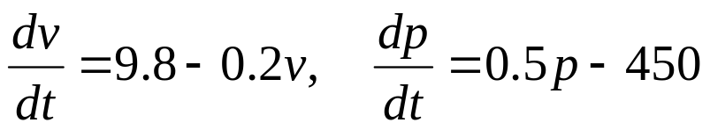
Ordinary Differential Equations
When the unknown function depends on a single independent variable, only ordinary derivatives appear in the equation.
In this case the equation is said to be an ordinary differential equations (ODE).
The equations discussed in the preceding two sections are ordinary differential equations. For example,

Slide 4
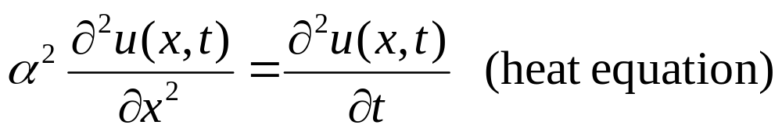
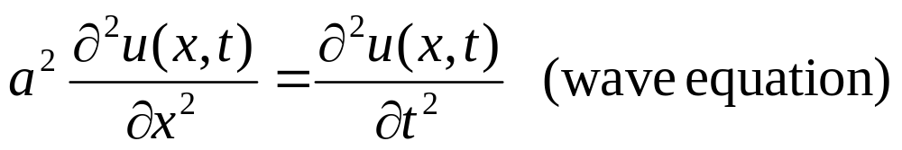
Partial Differential Equations
When the unknown function depends on several independent variables, partial derivatives appear in the equation.
In this case the equation is said to be a partial differential equation (PDE).
Examples:

Slide 5


Systems of Differential Equations
Another classification of differential equations depends on the number of unknown functions that are involved.
If there is a single unknown function to be found, then one equation is sufficient. If there are two or more unknown functions, then a system of equations is required.
For example, predator-prey equations have the form
where x(t) and y(t) are the respective populations of prey and predator species. The constants a, c, α, γ depend on the particular species being studied.
Systems of equations are discussed in Chapter 7.

Slide 6


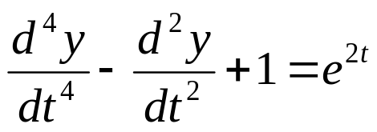


Order of Differential Equations
The order of a differential equation is the order of the highest derivative that appears in the equation.
Examples:
We will be studying differential equations for which the highest derivative can be isolated:

Slide 7


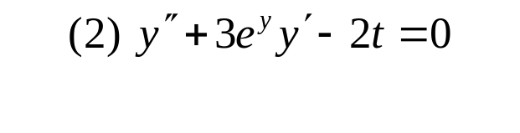
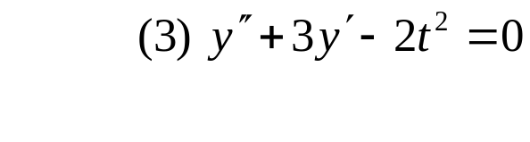
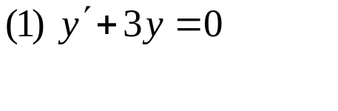
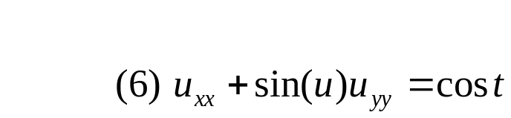
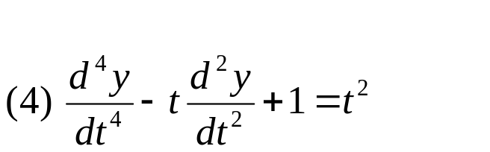
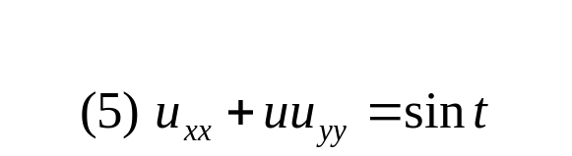
Linear & Nonlinear Differential Equations
An ordinary differential equation
is linear if F is linear in the variables
Thus the general linear ODE has the form
Example: Determine whether the equations below are linear or nonlinear.

Slide 8


Solutions to Differential Equations
A solution φ(t) to an ordinary differential equation
satisfies the equation:
Example: Verify the following solutions of the ODE

Slide 9
Solutions to Differential Equations
Three important questions in the study of differential equations:
  Is there a solution? (Existence)
  If there is a solution, is it unique? (Uniqueness)
  If there is a solution, how do we find it?
    (Analytical Solution, Numerical Approximation, etc)

